Slide 1

TABLEAU REINFORCEMENT
SUCHANTH B
28/02/2025

Slide 2
Agenda
INTRO TO TABLEAU
PROBLEM STATEMENT
DATA VISUALIZATIONS
DASHBOARDS AND STORY TELLING
CONCLUSIONS

Slide 3
INTRODUCTION TO TABLEAU

Slide 4

Tableau is a visual analytics platform that is revolutionizing the way we use data to solve problems by enabling individuals and organizations to make the most of their data.
Tableau is the fastest and most powerful visualization tools. It is very easy to use. There are no complex formulas like Excel and other visualization tools

Slide 5

The dataset appears to be sourced from an employee performance tracking system. It includes various details about employees, their job-related attributes, and performance metrics. The dataset consists of 200 employee records and 15 attributes: employee _ id, employee _ name, age, gender, department, job _ title, hire _ date, performance _ rating, attendance_ percentage, overtime _ hours, communication _ skills, teamwork _ skills, project _ completion _ rate , salary , bonus _ amount . By analyzing performance ratings with factors like teamwork and communication skills, we can assess key contributors to high performance.

Slide 6

DATA VISUALIZATION

Slide 7
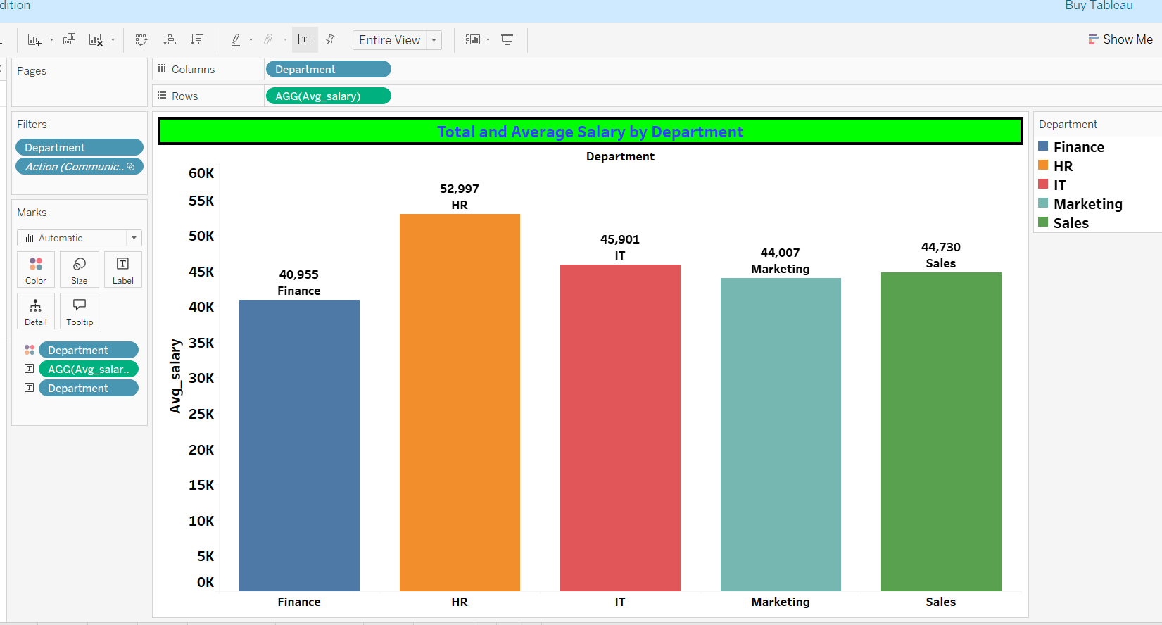

Slide 8
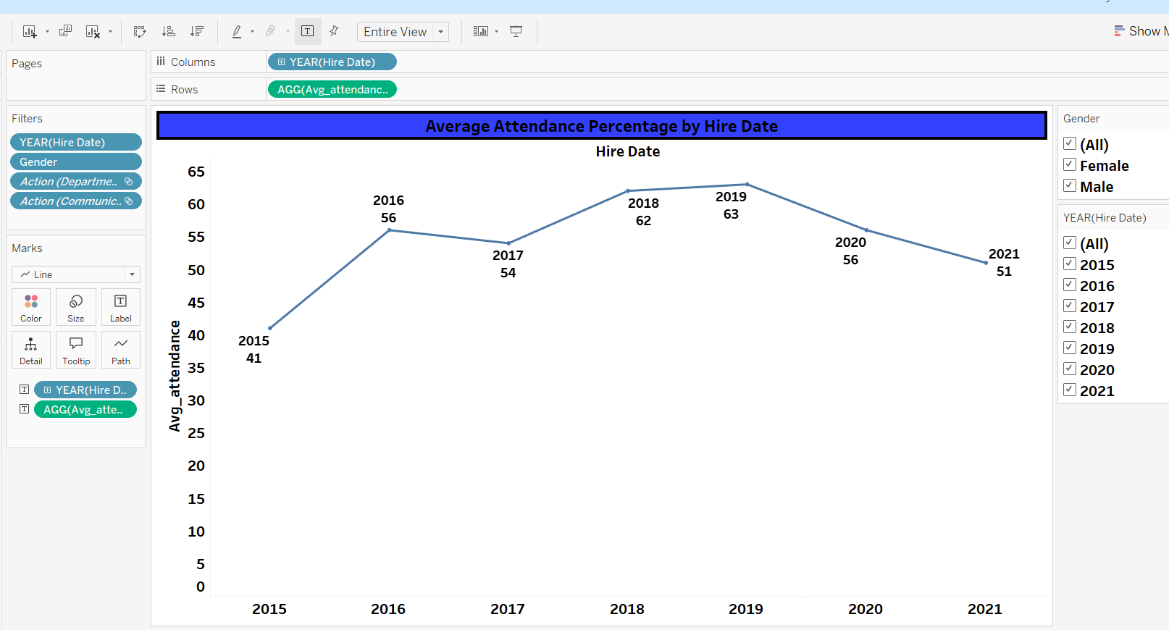

Slide 9
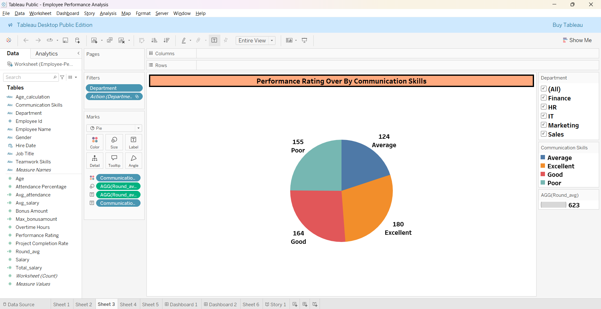

Slide 10
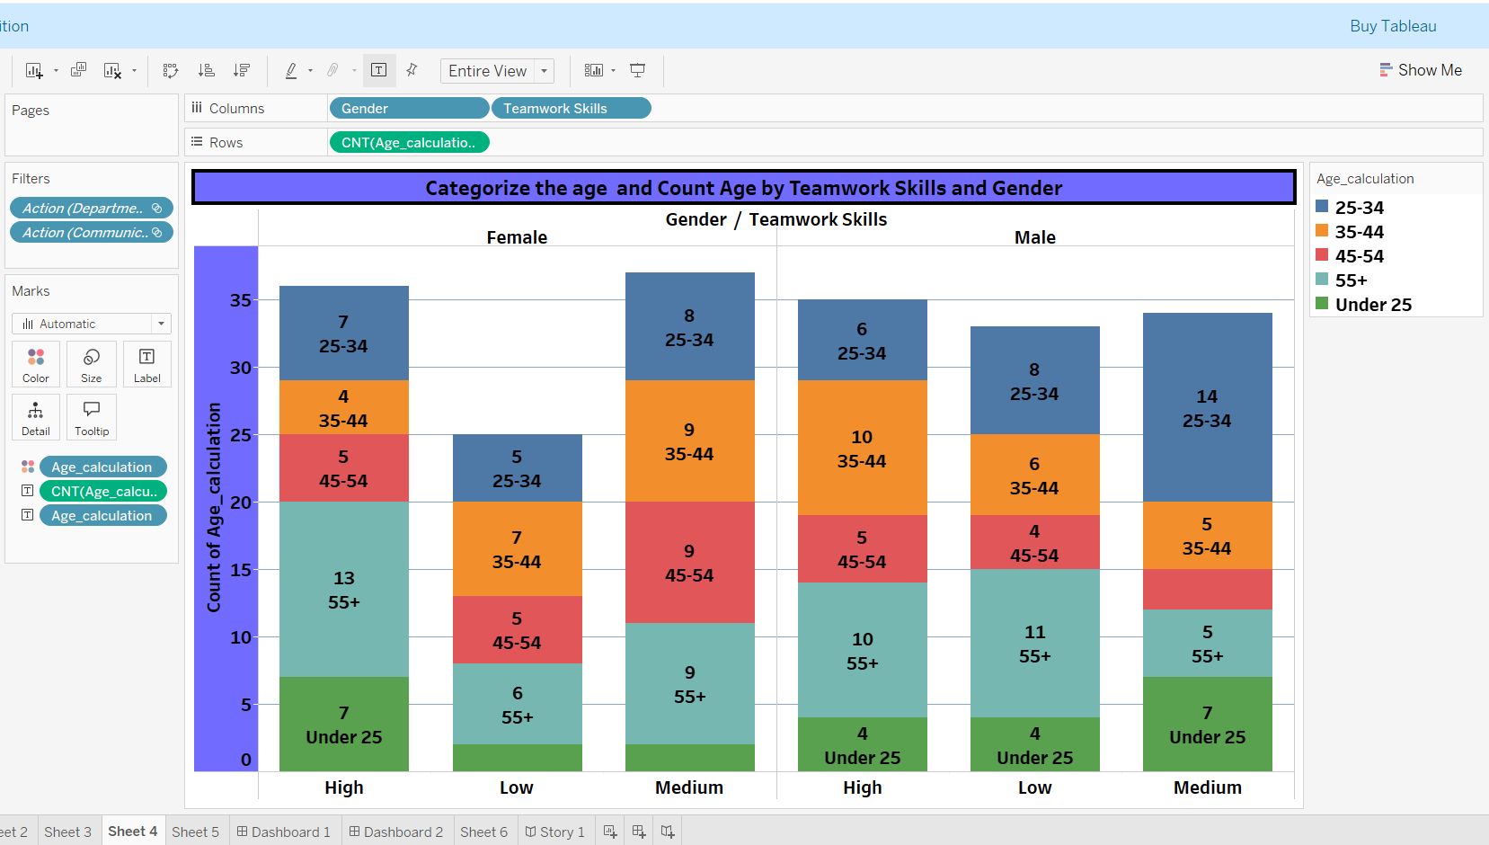

Slide 11
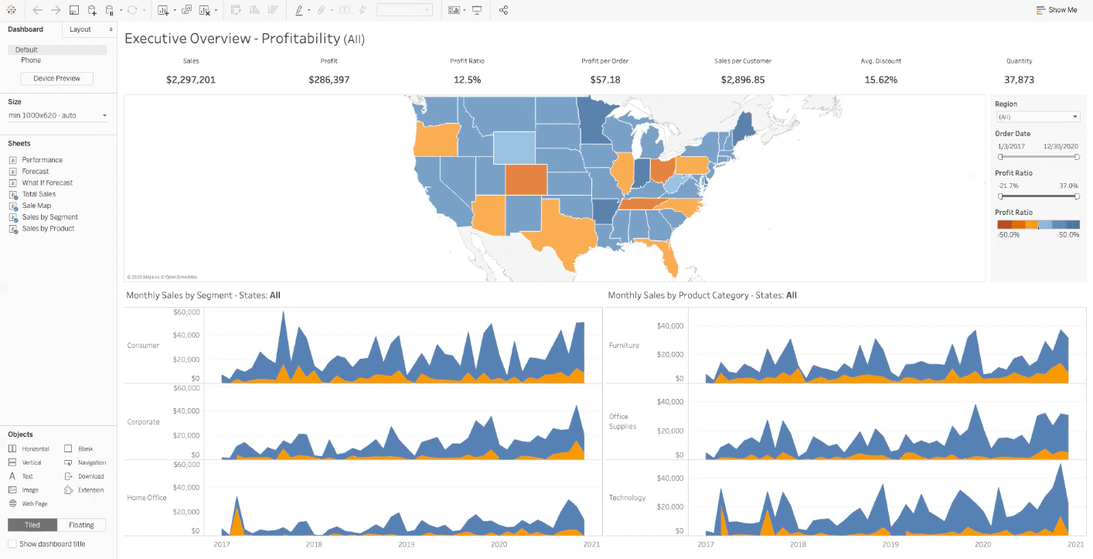
DASHBOARD AND STORY TELLING

Slide 12
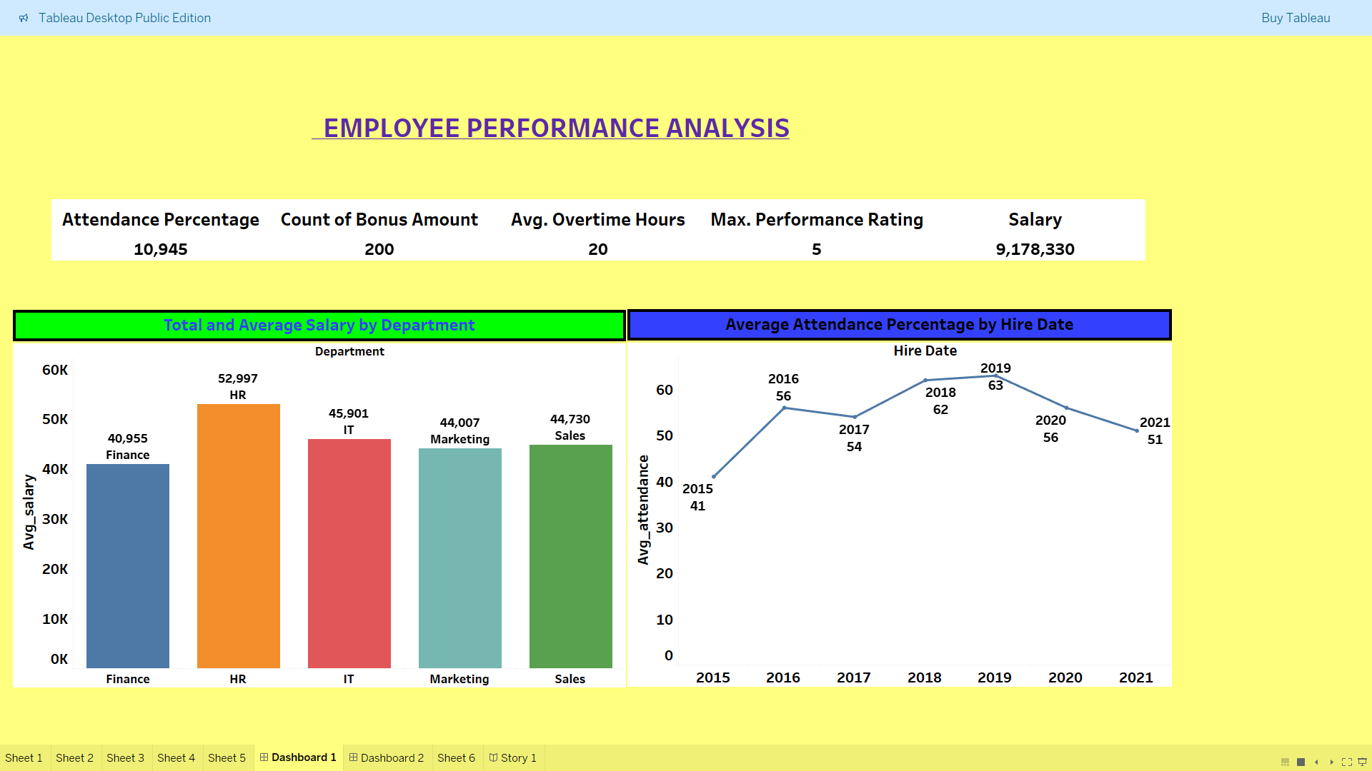

Slide 13
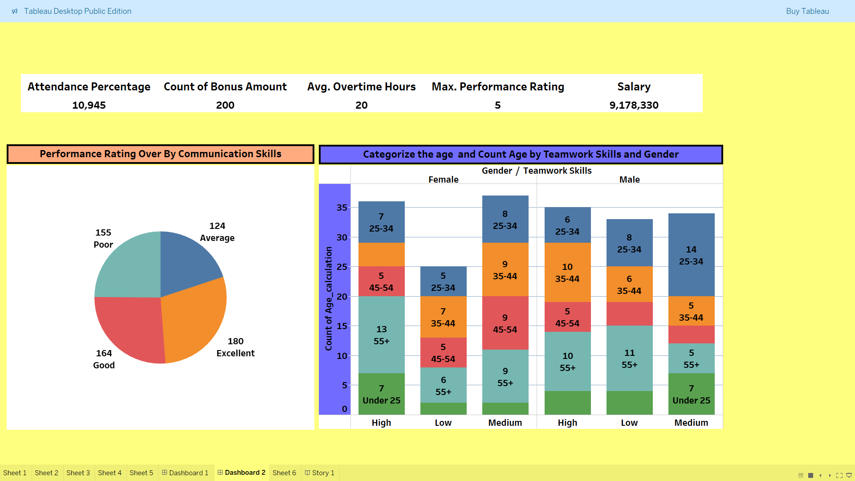

Slide 14
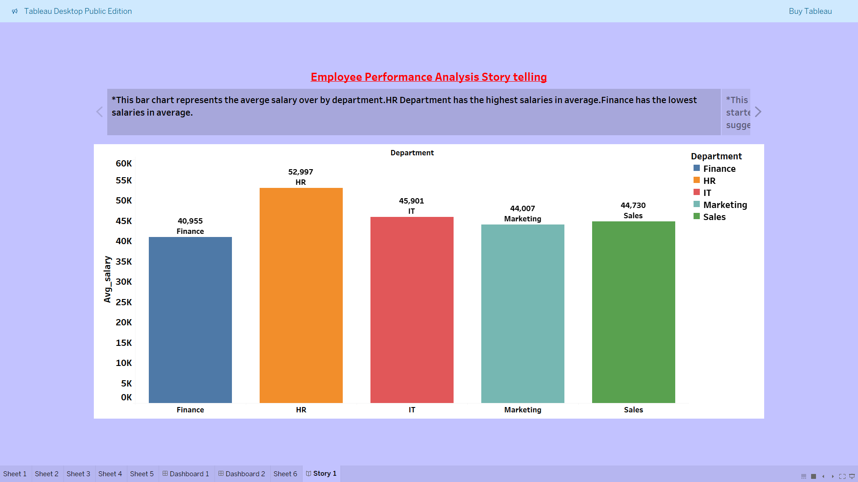

Slide 15
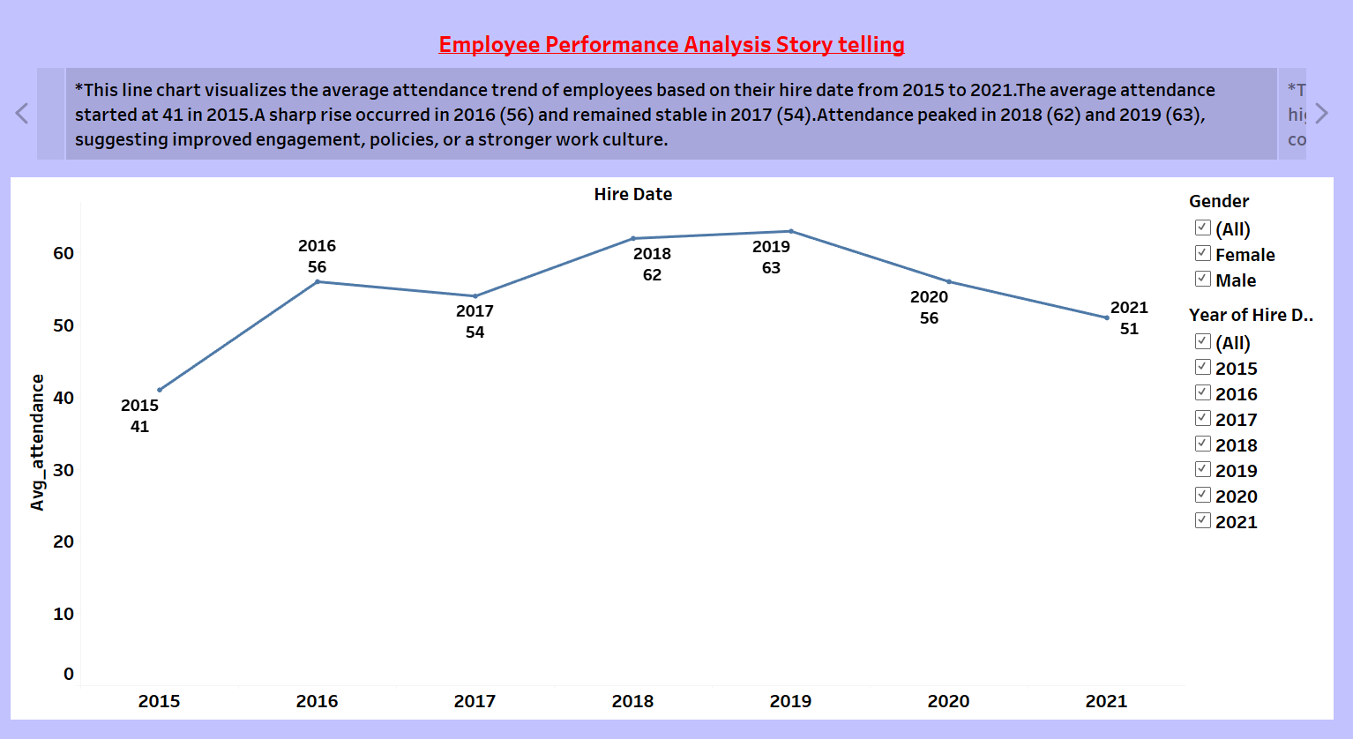

Slide 16
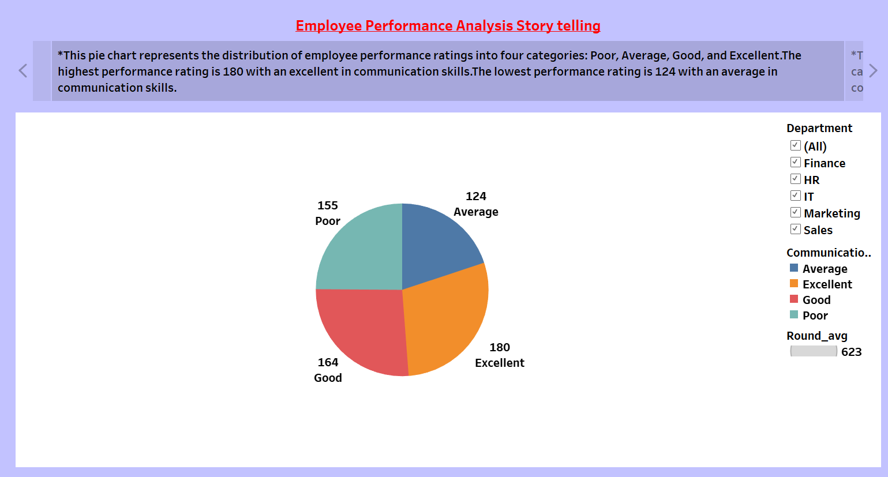

Slide 17
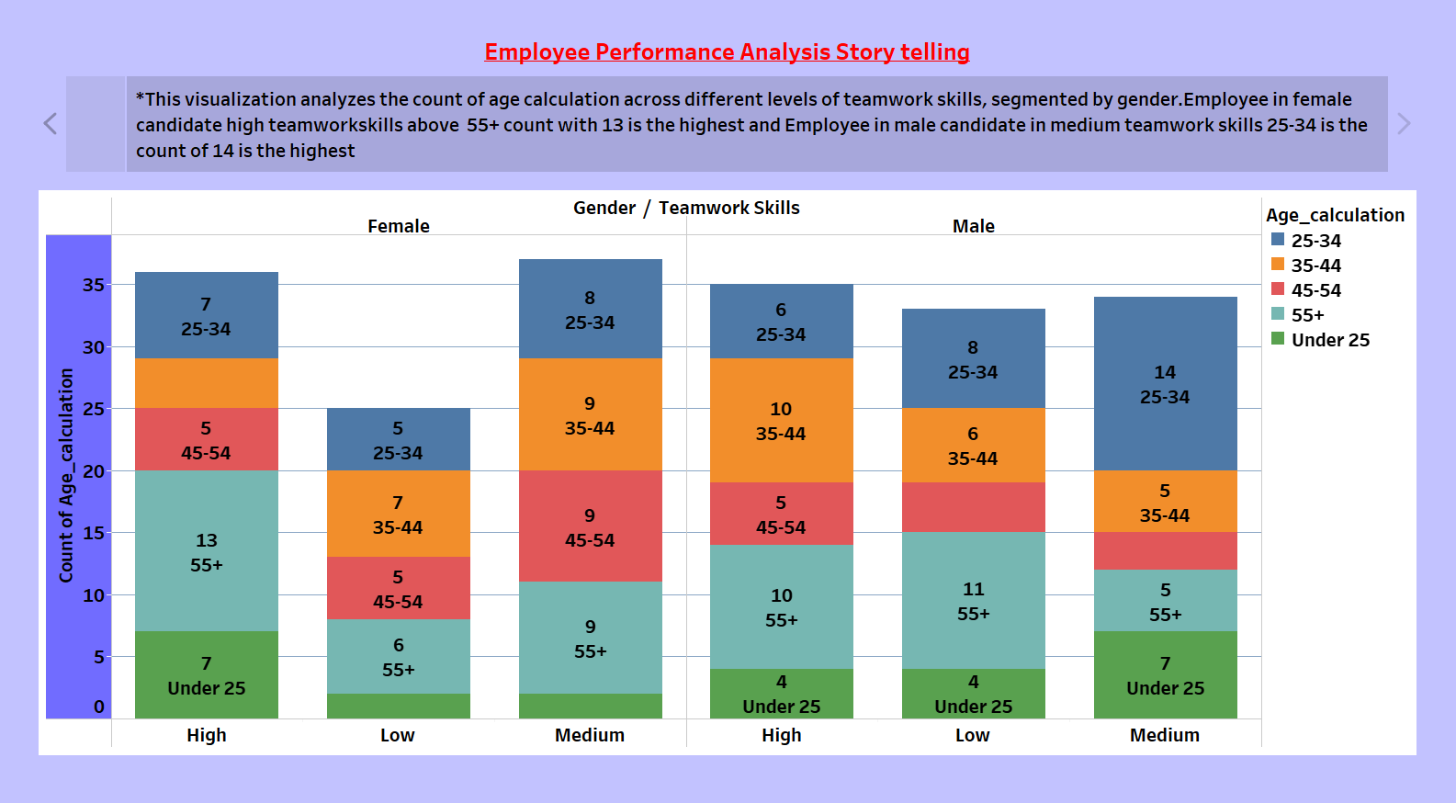

Slide 18
CONCLUSIONS:
Targeted Support for Low-Performing Departments: Provide additional support and resources to
departments with lower average performance ratings to enhance productivity.
Attendance Improvement Strategies: Implement strategies to improve attendance rates, such as
flexible work schedules or attendance incentives, to boost overall performance.
Effective Overtime Management: Develop and enforce policies to manage overtime effectively,
ensuring that it contributes positively to employee performance without causing burnout.

Slide 19


